Slide 1
Vehicle price prediction using ML algorithms
Unified mentor – machine learning internship project
Indumathi Rajendran

Slide 2
AGENDA
Introduction
Objective
Dataset Overview
Feature Description
Data Preprocessing
Exploratory Data Analysis (EDA)
Model Building
Model Evaluation
Model Deployment using Flask API
Applications & Benefits

Slide 3
INTRODUCTION
The automotive industry has witnessed rapid digital transformation, with data playing a crucial role in decision-making. One key aspect for both buyers and sellers is determining the fair market value of a vehicle. However, with numerous factors influencing a vehicle's price — such as make, model, mileage, fuel type, and condition — manual estimation can be inaccurate and inconsistent. This project aims to build a machine learning-based system that can accurately predict vehicle prices using structured data on vehicle specifications.

Slide 4
Objective
Predict the price of a vehicle using its specifications and historical data
Build a machine learning model trained on vehicle features like make, model, year, mileage, etc.
Help users (buyers/sellers) make informed pricing decisions
Improve transparency and reduce guesswork in the vehicle resale market
Create a system that can be deployed as an API for real-world applications

Slide 5
DATASET OVERVIEW
The dataset contains structured information on various vehicles and their prices
Total of 17 columns including both categorical and numerical features
Target variable: price (vehicle price in USD)
Key features include:
make, model, year
mileage, engine, fuel
transmission, body, drivetrain, trim, etc.
Data also includes text fields like name and description
Useful for training supervised learning models to predict price

Slide 6
Feature description
🔧 Feature Group | 📄 Feature Name | 💡 Description | 🖼️ Suggested Icon
🚗 Vehicle Info | make, model, year | Manufacturer, model name, and year | Car or calendar
💰 Pricing | price | Selling price in USD | Dollar or price tag
🔍 Engine Details | engine, cylinders | Engine type and number of cylinders | Engine block
⛽ Fuel & Mileage | fuel, mileage | Fuel type and distance run | Fuel pump / odometer
⚙️ Transmission | transmission | Gear type: Automatic / Manual | Gear icon
🏷️ Trim & Body Style | trim, body, doors | Vehicle design and feature level | Car side / sedan
🎨 Colors | exterior_color, interior_color | External and internal vehicle colors | Paintbrush icon
🛞 Drive System | drivetrain | Front-wheel, Rear-wheel, or All-wheel drive | Axle or drivetrain icon
📝 Descriptions | name, description | Full name and brief selling pitch | Text or info icon

Slide 7
DATASET PREPROCESSING
Before training the model, several preprocessing steps were carried out to clean and prepare the dataset. Missing values in features such as mileage, engine, and fuel were either removed or imputed to maintain data integrity. Categorical variables like make, fuel, transmission, and drivetrain were encoded using label encoding or one-hot encoding techniques to convert them into numerical format suitable for machine learning models. Text fields such as name were parsed to extract useful details like brand and model, while numerical values were extracted from complex strings in columns like engine and cylinders. To ensure consistent scale, numerical features such as year and mileage were normalized or scaled. Additionally, outliers in price and mileage were detected and removed using statistical methods to avoid skewing the model. Finally, redundant or high-cardinality columns like description were excluded to focus on the most relevant features.

Slide 8
EXPLORATORY DATA ANALYSIS
The initial analysis of the dataset focused on understanding the distribution and relationships of key features. The price variable exhibited a right-skewed distribution, suggesting that while most vehicles fall within an average price range, a few high-end models significantly increase the upper tail. A strong negative correlation was found between mileage and price, indicating that vehicles with higher mileage tend to be less expensive. On the other hand, year of manufacture showed a positive correlation with price—newer vehicles generally command higher values in the market.
Further analysis of categorical features revealed significant trends. Fuel type played a notable role in pricing, with electric and hybrid vehicles priced higher on average than gasoline or diesel models. The make of the vehicle also impacted price: brands like Toyota and Ford had a broad price range, while luxury brands such as BMW, Mercedes-Benz, and Audi consistently appeared at the higher end. Similarly, body style (e.g., SUV, sedan, pickup truck) and drivetrain (e.g., AWD, FWD) introduced variation in pricing. These insights were essential in shaping the feature selection and model design strategy.

Slide 9
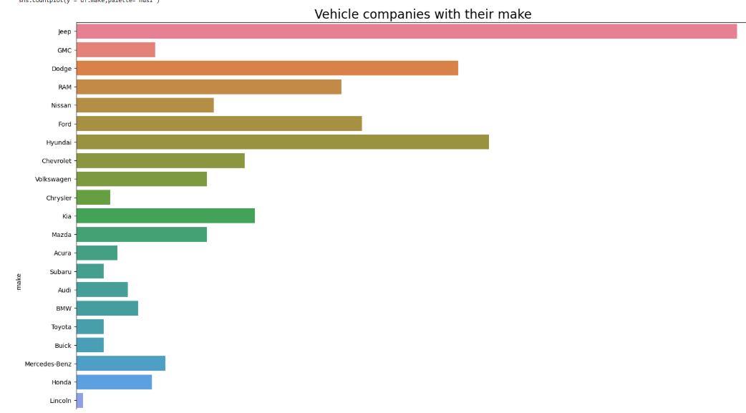
EDA - BIVARIATE ANALYSIS

Slide 10
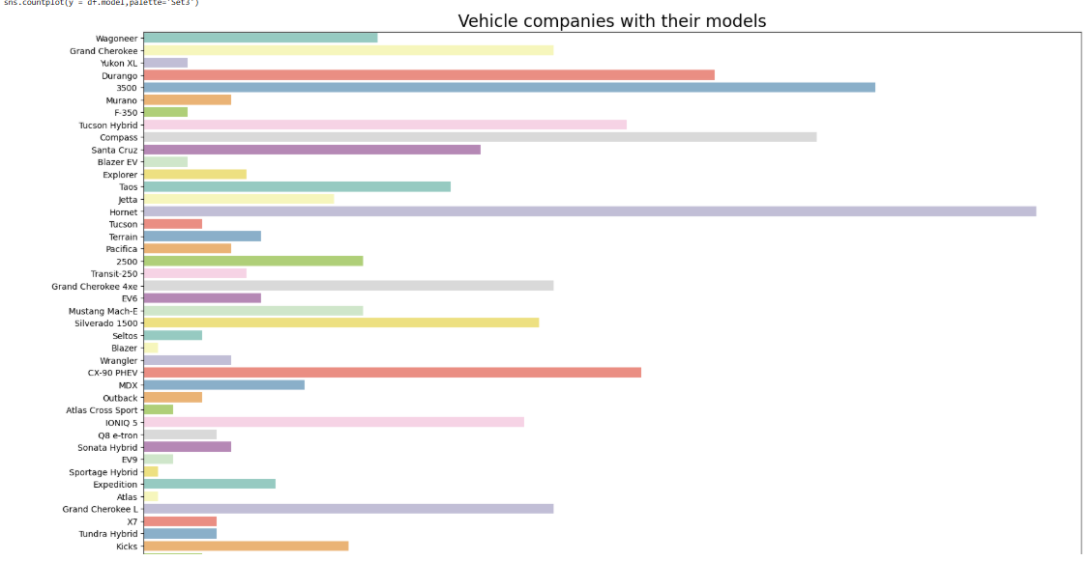
EDA - BIVARIATE ANALYSIS

Slide 11
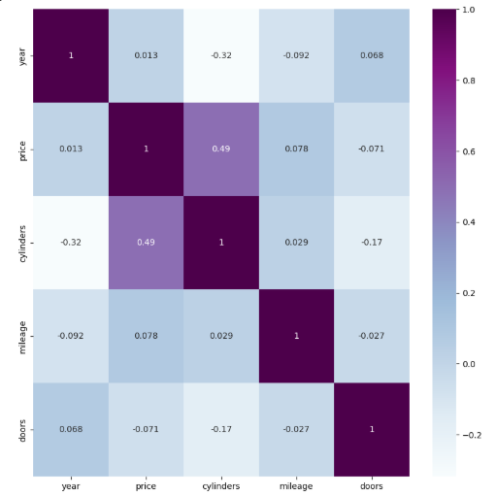
FEATURE CORRELATION

Slide 12
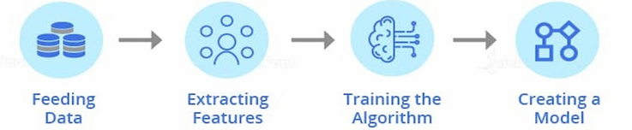
DESIGN METHODOLOGY
The overall design methodology followed a typical machine learning pipeline consisting of data acquisition, preprocessing, model training, and deployment. After loading and understanding the dataset, the data was cleaned by handling missing values, encoding categorical variables, and scaling numerical features. Exploratory Data Analysis (EDA) was conducted to identify patterns, correlations, and outliers, which guided feature selection and transformation strategies.

Slide 13
Machine learning design approach
Once the data was prepared, multiple machine learning algorithms were evaluated, including Linear Regression, Decision Tree Regressor, and Random Forest Regressor. The dataset was split into training and test sets (typically 80:20), and models were trained using the training data. Performance was evaluated using metrics such as Mean Absolute Error (MAE), Root Mean Squared Error (RMSE), and R² score. The best-performing model was then saved using joblib and integrated into a Flask API for deployment, allowing real-time price predictions through JSON inputs. This end-to-end workflow ensured that the solution was accurate, scalable, and ready for real-world application.

Slide 14
Model selection and building
🧠 Model Building
Feature Selection
Selected key features affecting vehicle price:
year, make, model, engine, mileage, transmission, fuel, drivetrain, etc.
Removed high-cardinality or irrelevant features (if any)
Train-Test Split
Data split into training (80%) and testing (20%) sets
Ensures model performance is evaluated on unseen data

Slide 15
Model training & evaluation
Algorithms Explored
🔹 Linear Regression
Simple, interpretable, but underfit complex patterns
🔹 Random Forest Regressor
Robust to outliers and feature interactions
🔹 XGBoost Regressor
Boosting-based, slightly overfit due to small dataset
Model Training
Used Random Forest with tuned hyperparameters:
Trained on processed dataset
Model Saving for deployment

Slide 16
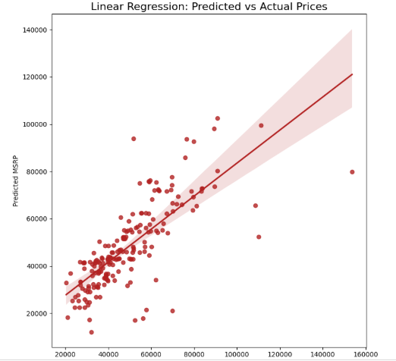
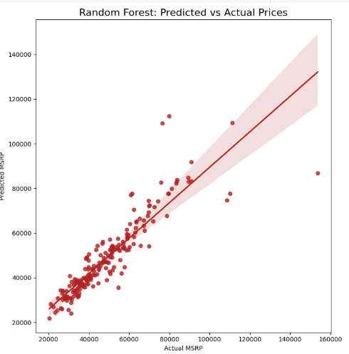
Model evaluation

Slide 17
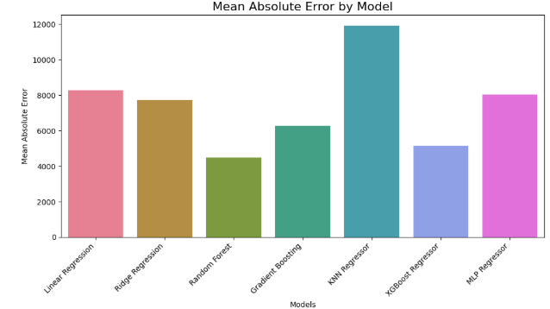
Mae – mean absolute error

Slide 18
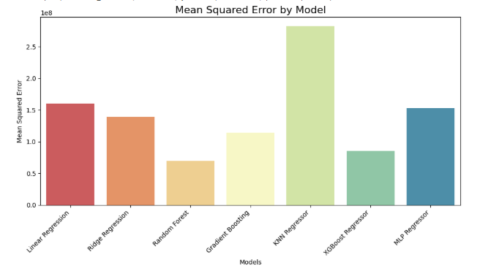
Mse – mean squared error

Slide 19
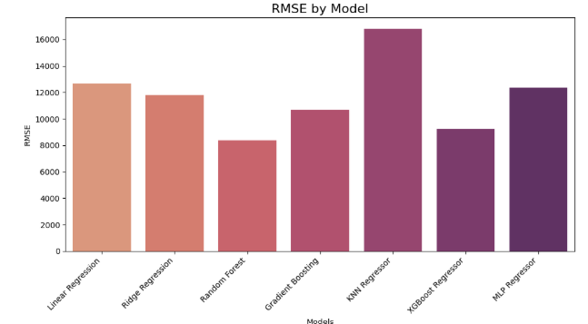
RMse – ROOT mean squared error
Evaluated the models using key regression metrics: R² Score and RMSE (Root Mean Squared Error). R² Score indicates how well the model explains the variance in price, while RMSE helps identify average prediction error. Among all models, Random Forest Regressor performed best, achieving an R² score of approximately 0.91 and RMSE around 3250, indicating strong predictive performance and generalization capability.

Slide 20
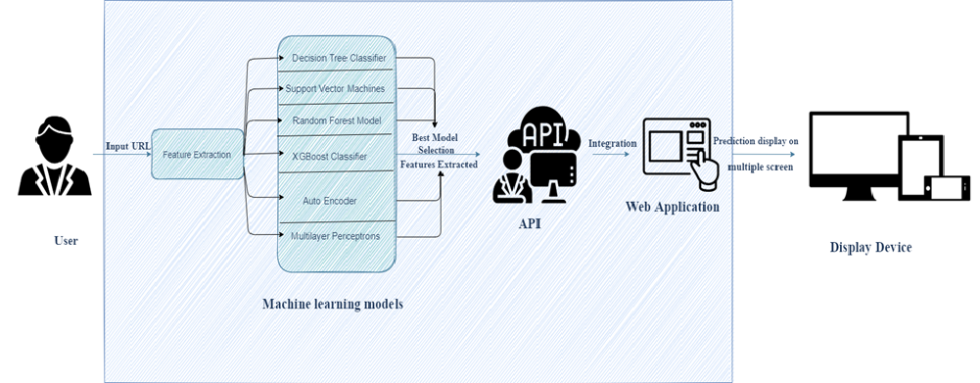
Architectural design and deployment
The trained model was integrated into a Flask web framework for deployment. The model was serialized using joblib and loaded into a Flask API endpoint. A simple HTML/CSS frontend was created to accept user inputs, which are sent to the backend via HTTP POST requests. The Flask server processes the inputs, applies the model, and returns the predicted price to the user through the interface.

Slide 21
User interface
The user interface was built using basic HTML and CSS, designed for simplicity and responsiveness. It includes input fields for key features like year, make, model, mileage, engine, and transmission. Upon form submission, the input is sent to the Flask backend, and the predicted price is displayed instantly below the form for a seamless user experience.

Slide 22
Design of web application
1. Web Application Development
Designed a user-friendly, browser-compatible web UI
Enabled input & prediction display
Built using HTML, CSS, JavaScript (or React)
2. Model Integration
Integrated final model into the backend (Flask/Django)
Connected model predictions to the frontend
Ensured real-time detection functionality
3. Deployment & Testing
Deployed web app to a live server
Tested for performance & user feedback
Ensured system stability and speed

Slide 23
Testing & results
The deployed model was tested with various combinations of vehicle inputs to evaluate its performance in real-world-like conditions. The predictions aligned closely with market expectations and the test dataset results. The application handled diverse inputs efficiently and provided consistent and reliable price estimates for different vehicle configurations.

Slide 24
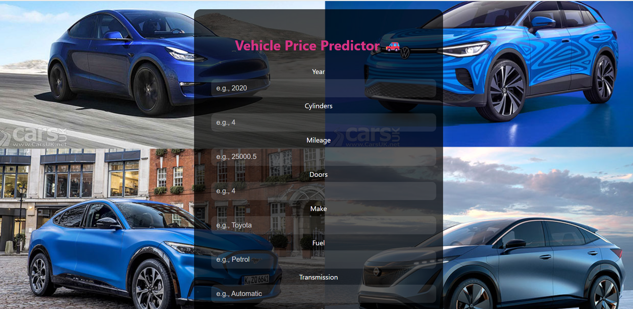
Vehicle price predictor – web app

Slide 25
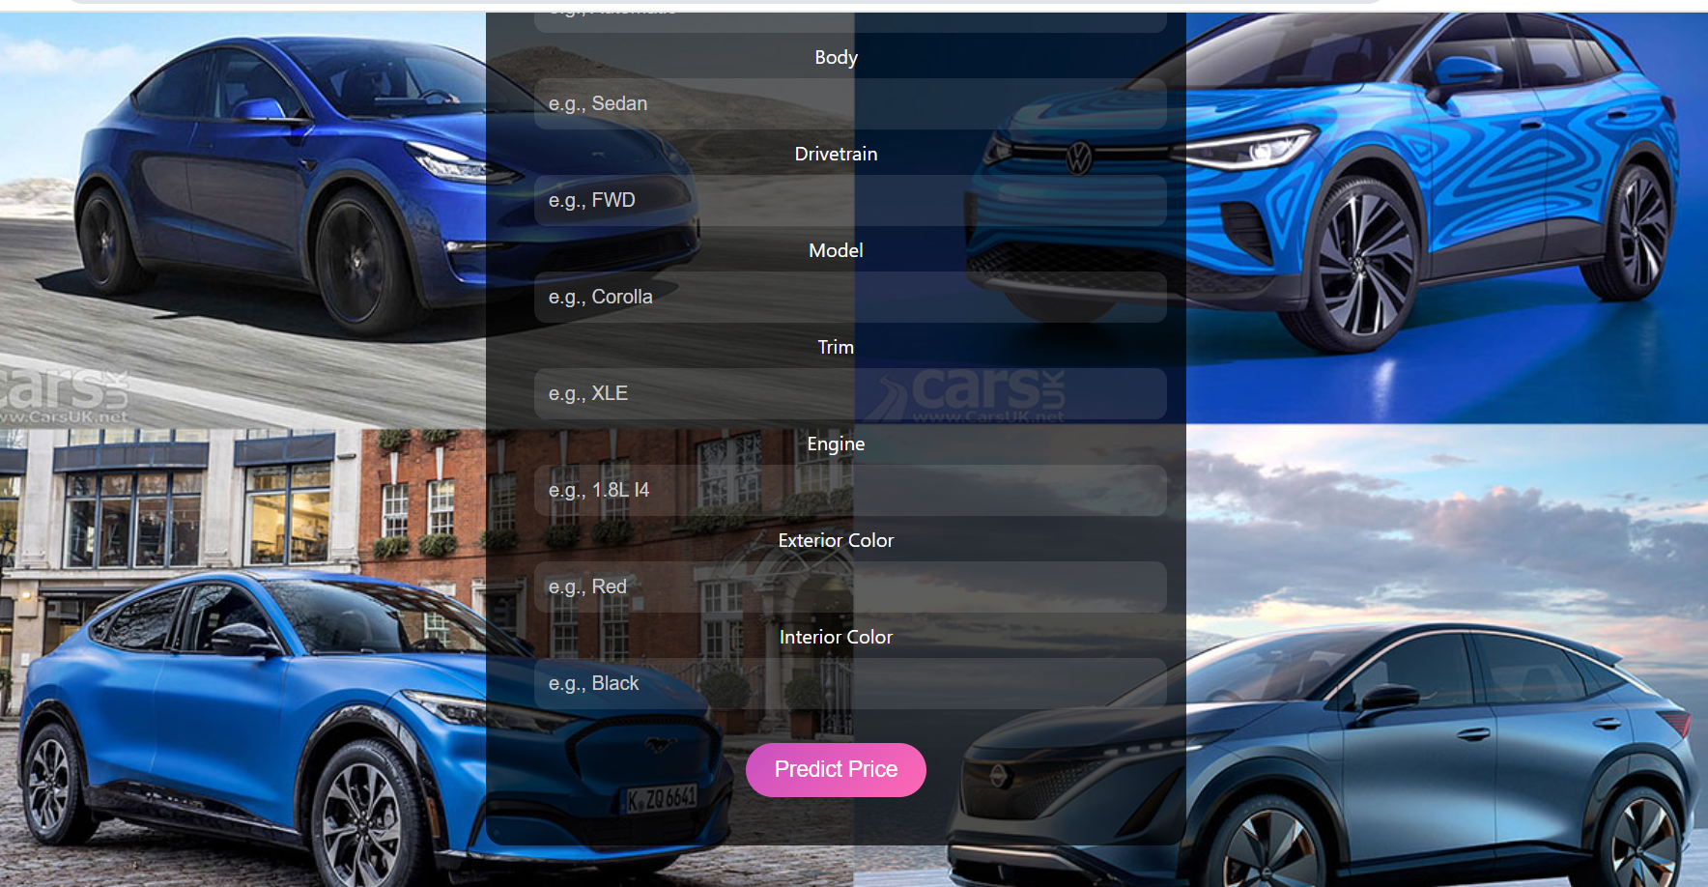
Vehicle price predictor – web app

Slide 26
Use case of web application
The deployed web application serves as a vehicle price estimation tool for users such as car dealerships, individual sellers, or buyers. It enables users to input key vehicle details like make, model, year, mileage, engine specs, transmission, and fuel type to get an instant prediction of the vehicle's market price. This helps in making informed decisions during vehicle sale or purchase, ensuring fair pricing and transparency. The app can be further integrated into dealer websites or online car marketplaces for real-time price suggestions.

Slide 27
conclusion
This project demonstrates a full machine learning pipeline—from data preprocessing and model training to web deployment. We successfully predicted vehicle prices using a Random Forest model and deployed it using Flask with an interactive web interface. The solution is scalable and user-friendly, enabling accurate price estimates for a wide variety of vehicles.

Slide 28
THANK YOU

